Slide 1
Emerging Technologies for the Circular Economy
Lecture 6: IoT – Data Processing and BigData
Prof. Dr. Benjamin Leiding
M.Sc. Anant Sujatanagarjuna
M.Sc. Shohreh Kia
Notes:
<number>

Slide 2
License
This work is licensed under a Creative Commons Attribution-ShareAlike 4.0 International License. To view a copy of this license, please refer to https://creativecommons.org/licenses/by-sa/4.0/ .
Updated versions of these slides will be available in our Github repository.

Slide 3
Motivation

Slide 4
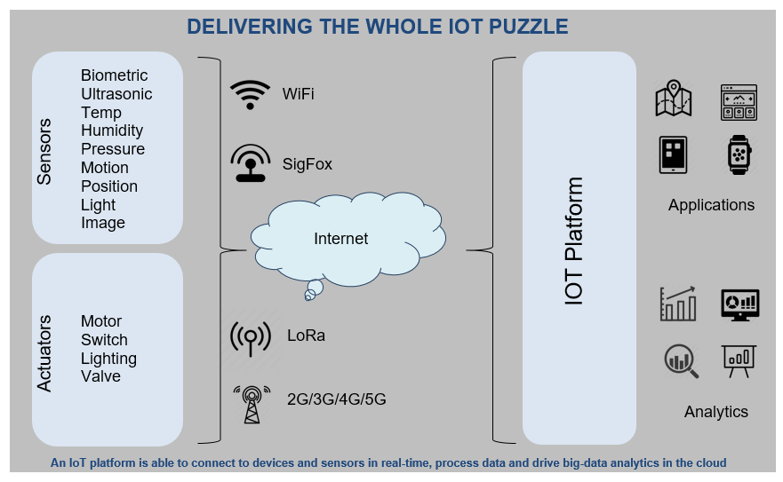
Overview

Slide 5
Clouds

Slide 6
Cloud Computing – Definition
“Cloud computing is a model for enabling ubiquitous, convenient, on-demand network access to a shared pool of configurable computing resources (e.g., networks, servers, storage, applications, and services) that can be rapidly provisioned and released with minimal management effort or service provider interaction.”
National Institute of Standards and Technology (NIST), “The NIST Definition of Cloud Computing”, 2011.

Slide 7
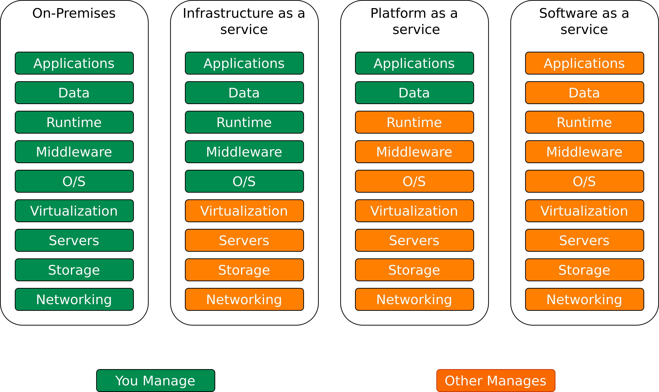
Overview
Image recreated from https://blogs.bmc.com

Slide 8
Cloud Service Models – Examples
IaaS:
Amazon Web Services (AWS)
Microsoft Azure
Google Compute Engine
PaaS:
Google App Engine
Heroku, OpenShift
AWS Elastic Beanstalk
SaaS:
Google Apps
Dropbox
Cisco Webex
Salesforce
GoToMeeting
Zoom

Slide 9
Cloud Service Models – Examples
IaaS:
Amazon Web Services (AWS)
Microsoft Azure
Google Compute Engine
PaaS:
Google App Engine
Heroku, OpenShift
AWS Elastic Beanstalk
SaaS:
Google Apps
Dropbox
Cisco Webex
Salesforce
GoToMeeting
Zoom

Slide 10
Cloud Service Models – Examples
IaaS:
Amazon Web Services (AWS)
Microsoft Azure
Google Compute Engine
PaaS:
Google App Engine
Heroku, OpenShift
AWS Elastic Beanstalk
SaaS:
Google Apps
Dropbox
Cisco Webex
Salesforce
GoToMeeting
Zoom

Slide 11
Cloud Billing Models
Pay-per-use (z.B. AWS S3, AWS ECU, etc.)
Base fee + Pay-per-use
Pay-per-user (Dropbox)
Pay-per-transaction
Pay-per-bandwidth/troughput

Slide 12
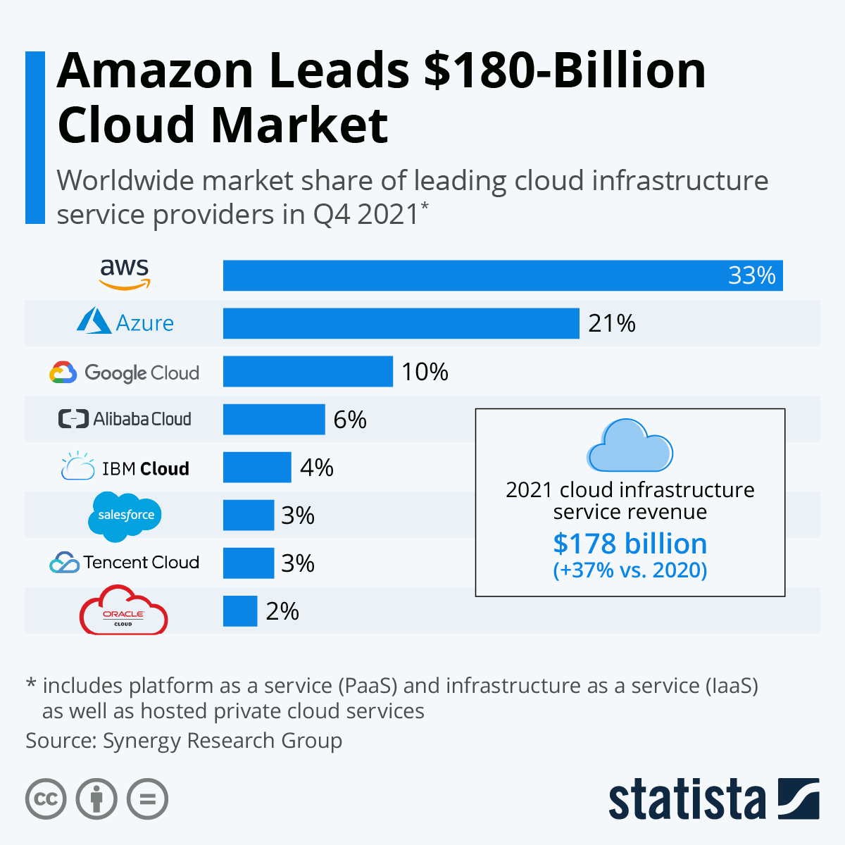
Cloud Platforms Market Shares
Image from https://www.statista.com/chart/18819/worldwide-market-share-of-leading-cloud-infrastructure-service-providers/ is licensed under
CC BY-ND 3.0 (https://creativecommons.org/licenses/by-nd/3.0/).

Slide 13
Cloud Billing Models – AWS Glacier Example
Storage pricing
$0.0045 per GB / Month
Retrieval pricing
Retrieval request pricing
Retrieval Time | Data Retrievals
Expedited | $0.036 per GB
Standard | $0.012 per GB
Bulk | $0.003 per GB
Retrieval Time | Retrieval Requests
Expedited | $12.00 per 1,000 requests
Standard | $0.036 per 1,000 requests
Bulk | $0.03 per 1,000 requests
https://aws.amazon.com/glacier/pricing/

Slide 14
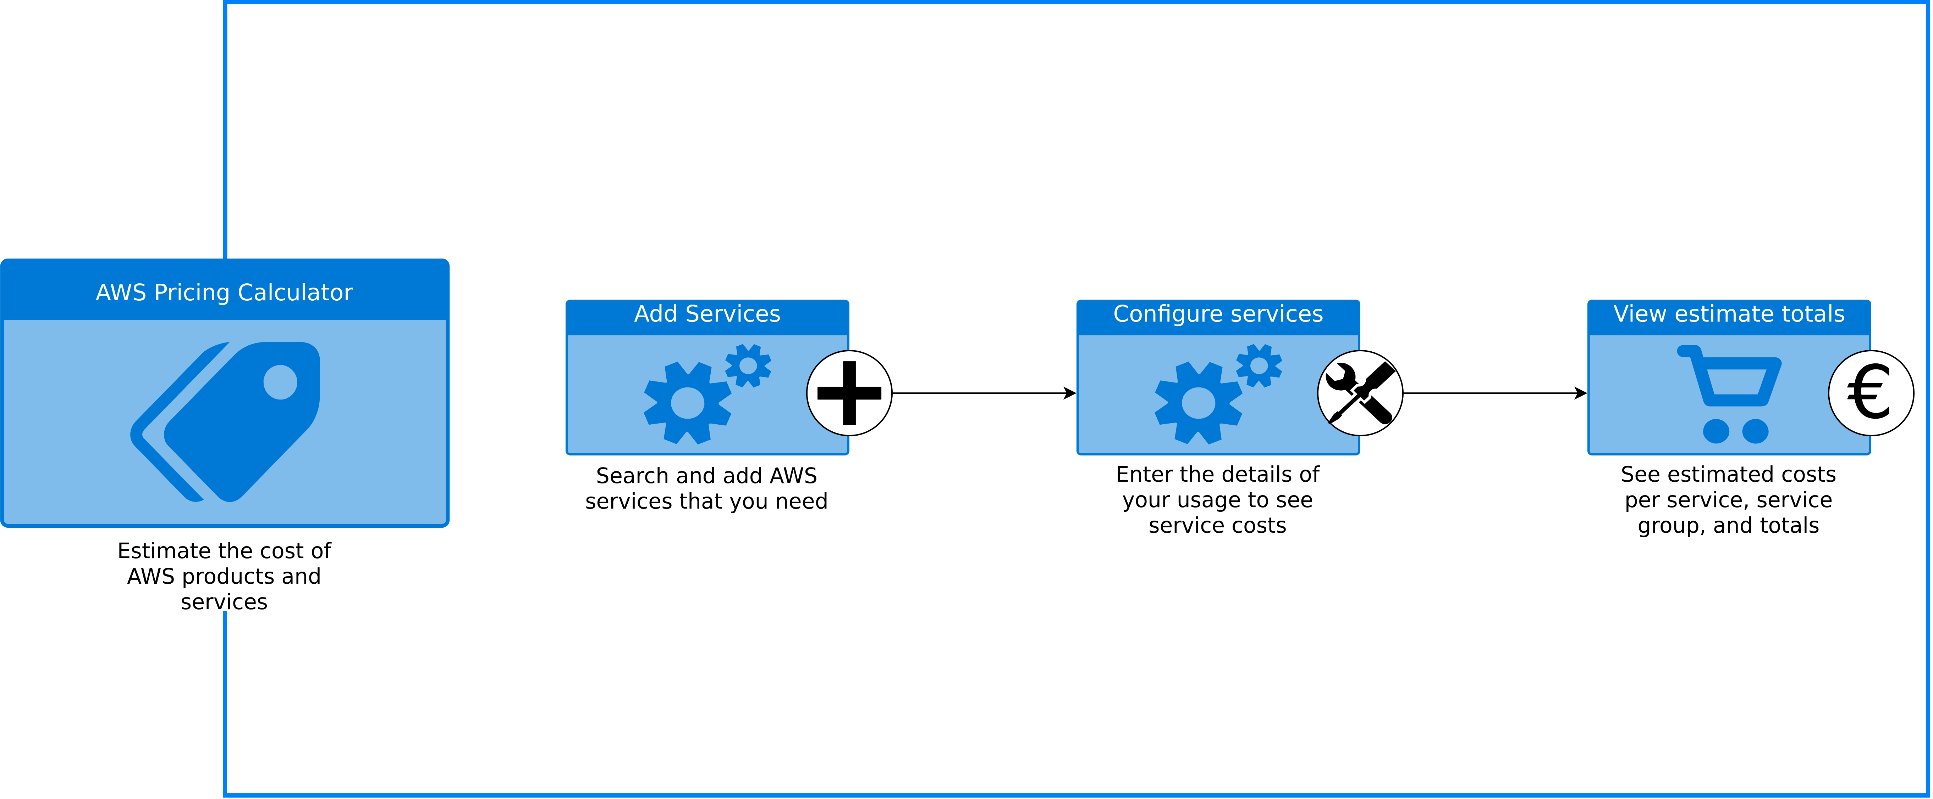
Cloud Billing Models – AWS Calculator
Image recreated based on https://calculator.aws/#/addService

Slide 15
Public, Hybrid and Private Clouds
Parameters/Type | Public cloud | Private cloud | Hybrid cloud | Community cloud
Description | Services are available for public users | Built up with existing private infrastructure. This type of cloud has some authentic users who can dynamically provision the resources | A heterogeneous distrubited system, resulting from a private cloud, which incorporates different types of services and resources from public clouds | Different types of cloud are integrated together to meet a common or particular need for some organizations
Scalability | Very High | Limited | Very High | Limited
Reliability | Moderate | Very High | Medium to High | Very High
Security | Totally depends on the service provider | High class security | Secure | Secure
Performance | Low to medium | Good | Good | Very Good
Cost | Cheaper | High Cost | Costly | Costly
Examples | Amazon EC2, Google AppEngine | VMWare, Microsoft KVM, Xen | IBM, HP, VMWare vCloud, Eucalyptus | SolaS Community Cloud, VMWare
Table reacreated from Pal, Debranjan, Sourav Chakraborty, and Amitava Nag. "Cloud Computing: A Paradigm Shift in IT Infrastructure“, 2015.

Slide 16
Public, Hybrid and Private Clouds
Parameters/Type | Public cloud | Private cloud | Hybrid cloud | Community cloud
Description | Services are available for public users | Built up with existing private infrastructure. This type of cloud has some authentic users who can dynamically provision the resources | A heterogeneous distrubited system, resulting from a private cloud, which incorporates different types of services and resources from public clouds | Different types of cloud are integrated together to meet a common or particular need for some organizations
Scalability | Very High | Limited | Very High | Limited
Reliability | Moderate | Very High | Medium to High | Very High
Security | Totally depends on the service provider | High class security | Secure | Secure
Performance | Low to medium | Good | Good | Very Good
Cost | Cheaper | High Cost | Costly | Costly
Examples | Amazon EC2, Google AppEngine | VMWare, Microsoft KVM, Xen | IBM, HP, VMWare vCloud, Eucalyptus | SolaS Community Cloud, VMWare
?
?
Table reacreated from Pal, Debranjan, Sourav Chakraborty, and Amitava Nag. "Cloud Computing: A Paradigm Shift in IT Infrastructure“, 2015.

Slide 17
Cloud – Data Protection and Privacy

Slide 18
Cloud – Data Protection and Privacy
Am I allowed to transfer the data to the cloud? (e.g. patient data)
Does the data have to be encrypted and/or anonymized/pseudonymized?
Am I allowed to transfer data to foreign servers?
Liability issues in the event of data loss and data manipulation
Access to the data on the part of the cloud provider, third parties or secret services
Cloud service is temporarily unavailable (SLAs – Service Level Agreements)

Slide 19
Cloud – Data Protection and Privacy
Am I allowed to transfer the data to the cloud? (e.g. patient data)
Does the data have to be encrypted and/or anonymized/pseudonymized?
Am I allowed to transfer data to foreign servers?
Liability issues in the event of data loss and data manipulation
Access to the data on the part of the cloud provider, third parties or secret services
Cloud service is temporarily unavailable (SLAs – Service Level Agreements)

Slide 20
Cloud – Data Protection and Privacy
Am I allowed to transfer the data to the cloud? (e.g. patient data)
Does the data have to be encrypted and/or anonymized/pseudonymized?
Am I allowed to transfer data to foreign servers?
Liability issues in the event of data loss and data manipulation
Access to the data on the part of the cloud provider, third parties or secret services
Cloud service is temporarily unavailable (SLAs – Service Level Agreements)

Slide 21
Cloud – Data Protection and Privacy
Am I allowed to transfer the data to the cloud? (e.g. patient data)
Does the data have to be encrypted and/or anonymized/pseudonymized?
Am I allowed to transfer data to foreign servers?
Liability issues in the event of data loss and data manipulation
Access to the data on the part of the cloud provider, third parties or secret services
Cloud service is temporarily unavailable (SLAs – Service Level Agreements)

Slide 22
Cloud – Data Protection and Privacy
Am I allowed to transfer the data to the cloud? (e.g. patient data)
Does the data have to be encrypted and/or anonymized/pseudonymized?
Am I allowed to transfer data to foreign servers?
Liability issues in the event of data loss and data manipulation
Access to the data on the part of the cloud provider, third parties or secret services
Cloud service is temporarily unavailable (SLAs – Service Level Agreements)

Slide 23
Cloud – Data Protection and Privacy
Am I allowed to transfer the data to the cloud? (e.g. patient data)
Does the data have to be encrypted and/or anonymized/pseudonymized?
Am I allowed to transfer data to foreign servers?
Liability issues in the event of data loss and data manipulation
Access to the data on the part of the cloud provider, third parties or secret services
Cloud service is temporarily unavailable (SLAs – Service Level Agreements)

Slide 24



Self-Hosted Storage Clouds
www.nextcloud.com
www.owncloud.com
www.syncthing.net

Slide 25
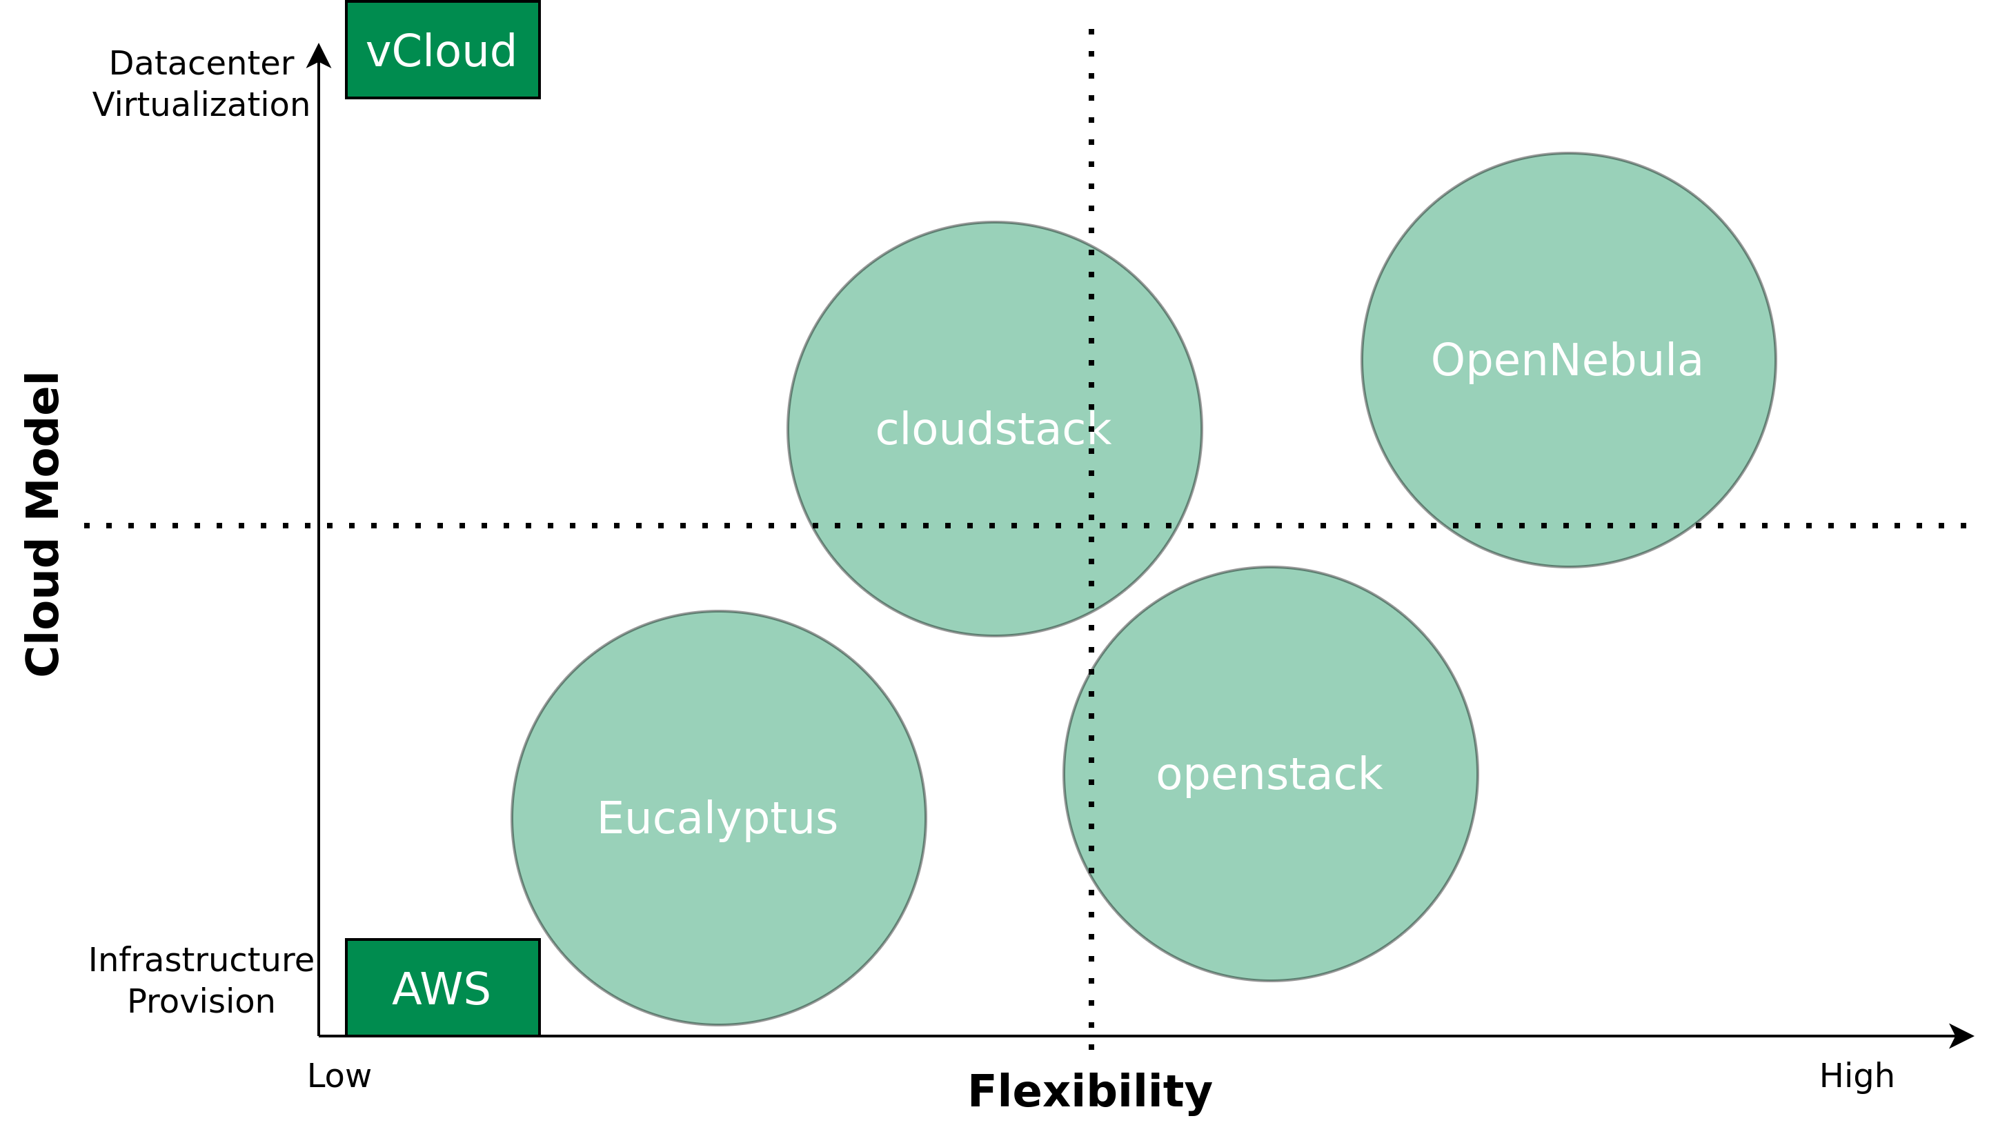
Self-Hosted Computing Clouds
Image recreated from https://opennebula.org

Slide 26
Iot Clouds

Slide 27
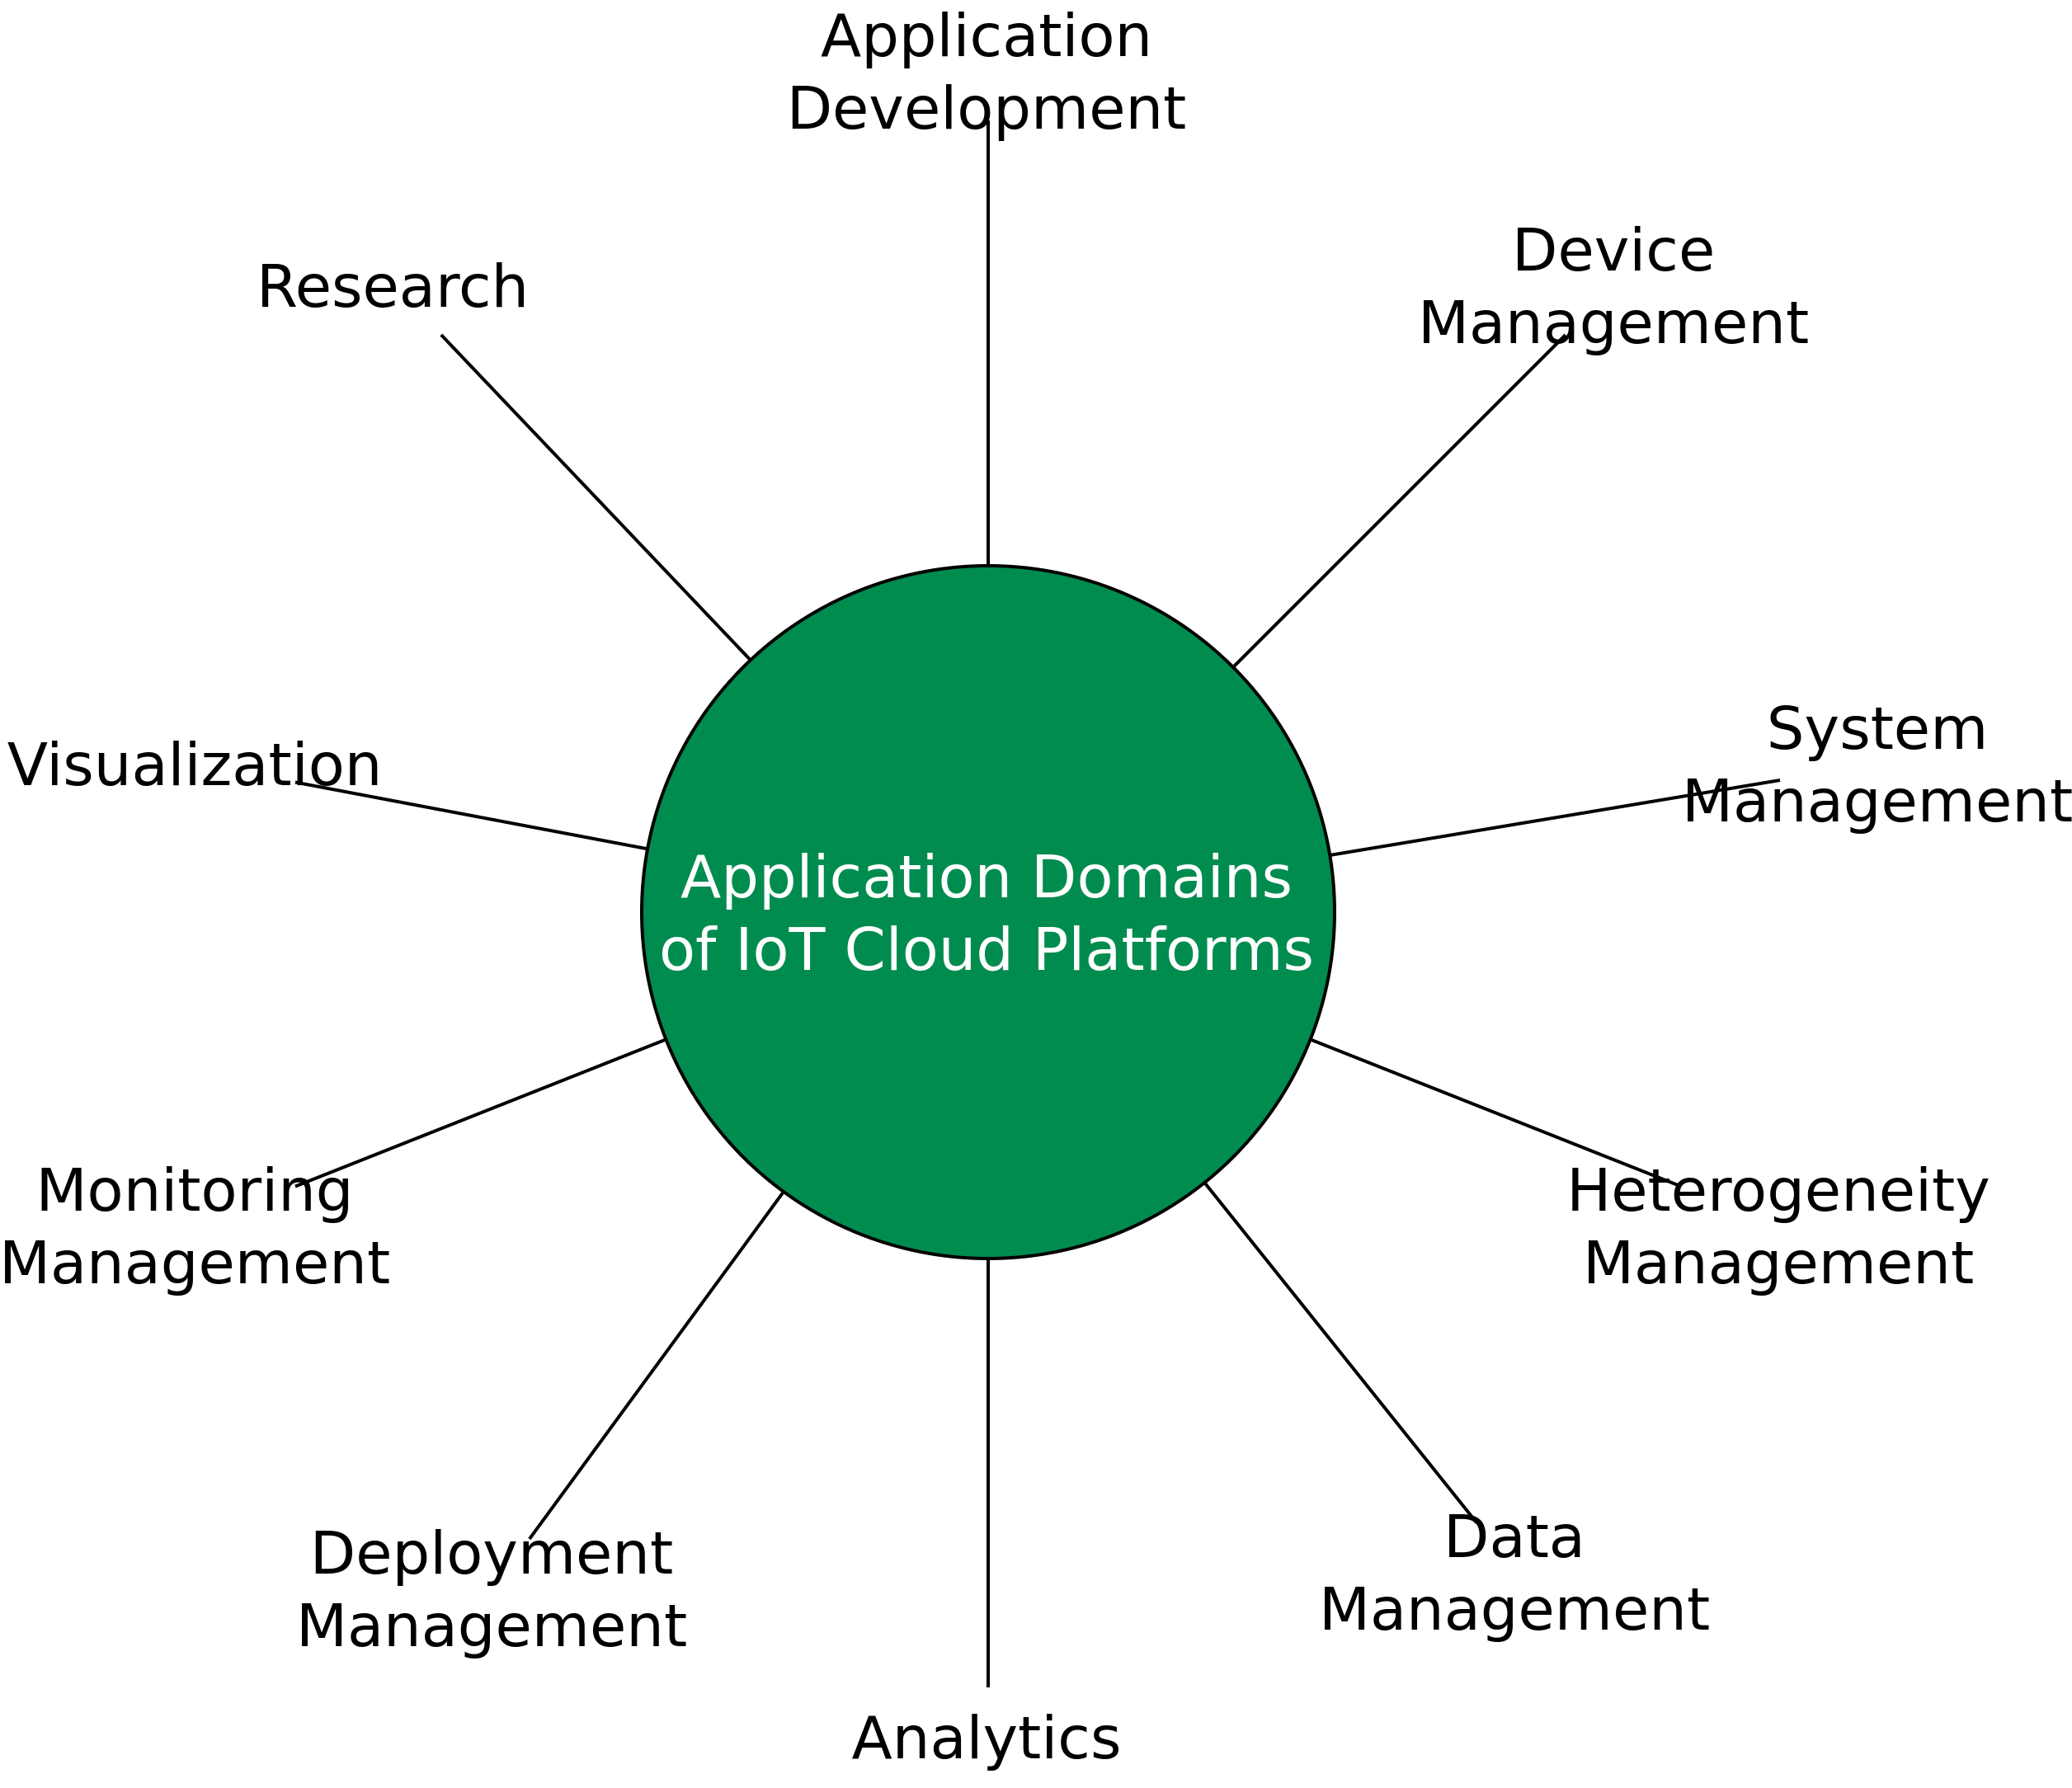
Domain-specific Clouds
Image recreated from P. P. Ray, “A Survey of IoT Cloud Platforms,” Future Computing and Informatics Journal, vol. 1, no. 1-2, pp. 35–46, 2016.

Slide 28
So what is an IoT Platform exactly?
IoT platforms are the support software that connects everything in an IoT system, thereby facilitating communication, data flow, device management, and the functionalities of applications.
Connect hardware, such as sensors and devices
Handle different hardware and software communication protocols
Provide security and authentication for devices and users
Collect, visualize, and analyze data the sensors and devices gather
(External) web-service or application integration

Slide 29
So what is an IoT Platform exactly?
IoT platforms are the support software that connects everything in an IoT system, thereby facilitating communication, data flow, device management, and the functionalities of applications.
Connect hardware, such as sensors and devices
Handle different hardware and software communication protocols
Provide security and authentication for devices and users
Collect, visualize, and analyze data the sensors and devices gather
(External) web-service or application integration

Slide 30
IoT Clouds
AWS IoT
ThingSpeak
Samsung Artik Cloud
Microsoft Azure IoT Platform
IBM Watson IoT

Slide 31
IoT Clouds – Comparison
Platform | FIWARE | OpenMTC | SiteWhere | Webinos | AWS IoT | IBM Watson IoT Platform | MS Azure IoT Hub | Samsung SmartThings
Sensor/Actuator | -* | Sensors & Actuators | -* | -* | -* | -* | -* | Sensors & Actuators & Devices & Users & Things
Device | Device/NGSI Device | -* | Data from Devices + Commands to Devices | PZP: Policy + Session + Discovery + Context Manager | Things | -* | Device | Sensors & Actuators & Devices & Users & Things + Clients (- Devices)
Gateway | IoT Edge | Front-End: Core Features + Connectivity + Back-End: Connectivity | -* | PZP: Sync + Messaging Manager + PZH: Sync Manager | -* | Connect | Cloud Protocol Gateway + Field Gateway | Hub and Client Connectivity + Device Type Handlers
IoT Integration Middleware | IoT Back-End + Data Context Broker | Back-End: Connectivity + Core Features + Application Enablement | SiteWhere Tenant Engine | PZH: User Authentication + Policy Repository + Policy Enforcement + Web APIs | Message Broker + Thing Shadows + Thing Registry + Rules Engine + Security & Identity | Analytics + Risk Management + Connect + Information Management + Bluemix Open Standards Based Services + Flexible Deployment | IoT Hub + Event Processing and Insight + Device Business Logic, Connectivity Monitoring + Application Device Provisioning and Management | Application Management System + Subscription Processing
Application | -* | Applications + Other M2M Platform | Integration- + REST-components | Third Party Applications | Amazon Services + IoT Applications | IoT Industry Solutions + Third Party Apps | Application Device Provisioning and Management | Event Stream + Web UI + Core APIs + External System + Physical Graph
Table recreated from Guth, Jasmin, Uwe Breitenbücher, Michael Falkenthal, Paul Fremantle, Oliver Kopp, Frank Leymann, and Lukas Reinfurt. "A detailed analysis of IoT platform architectures: concepts, similarities, and differences." In Internet of everything, pp. 81-101. Springer, Singapore, 2018.

Slide 32
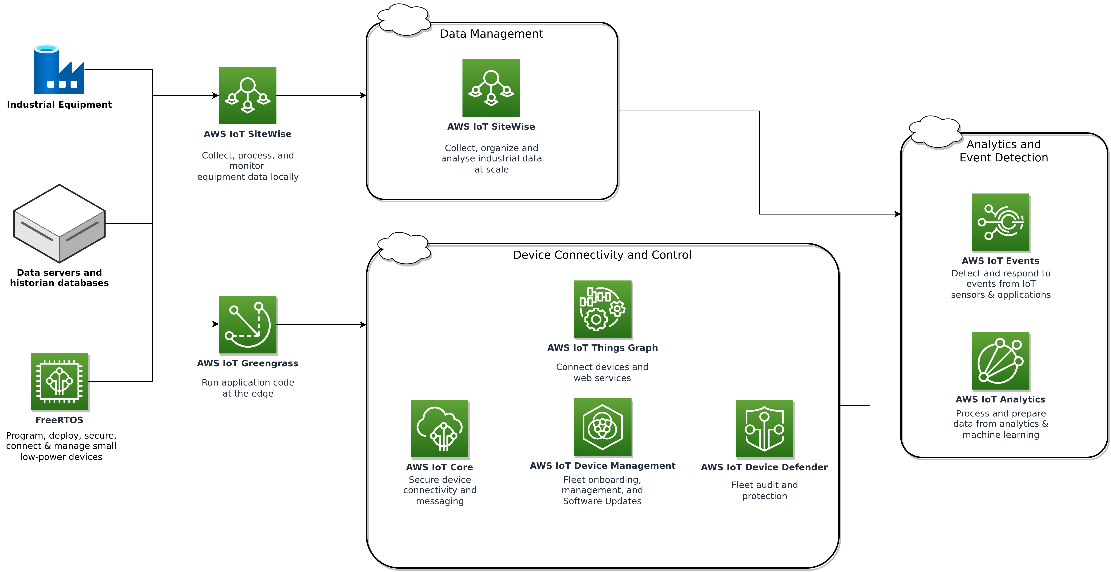
AWS IoT for Industrial Applications
Image recreated from https://aws.amazon.com/iot/solutions/industrial-iot

Slide 33
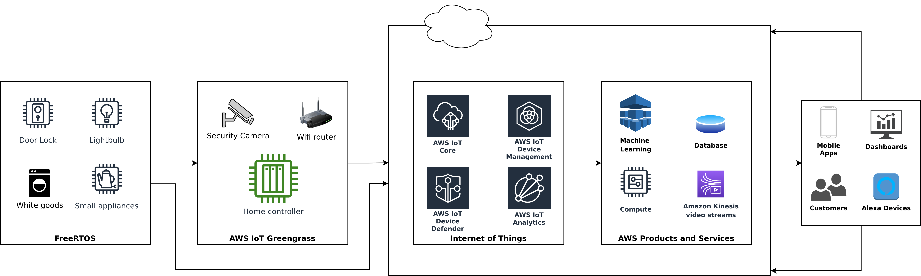
AWS IoT for the Connected Homes
Image recreated from https://aws.amazon.com/iot/solutions/connected-home

Slide 34
Edge/Fog Computing

Slide 35
Motivation
Why do we need Edge/Fog computing if we have a Cloud?
Data volume to large
Network latency
Costs (data transport constraints/limitations)
→ Edge computing shifts the computing capacity from central servers or the cloud closer to the IoT devices themselves. Thus, allowing for faster data processing, shorter response times, and saving bandwidth.

Slide 36
Motivation
Why do we need Edge/Fog computing if we have a Cloud?
Data volume to large
Network latency
Costs (data transport constraints/limitations)
→ Edge computing shifts the computing capacity from central servers or the cloud closer to the IoT devices themselves. Thus, allowing for faster data processing, shorter response times, and saving bandwidth.

Slide 37
Motivation
Why do we need Edge/Fog computing if we have a Cloud?
Data volume to large
Network latency
Costs (data transport constraints/limitations)
→ Edge computing shifts the computing capacity from central servers or the cloud closer to the IoT devices themselves. Thus, allowing for faster data processing, shorter response times, and saving bandwidth.

Slide 38
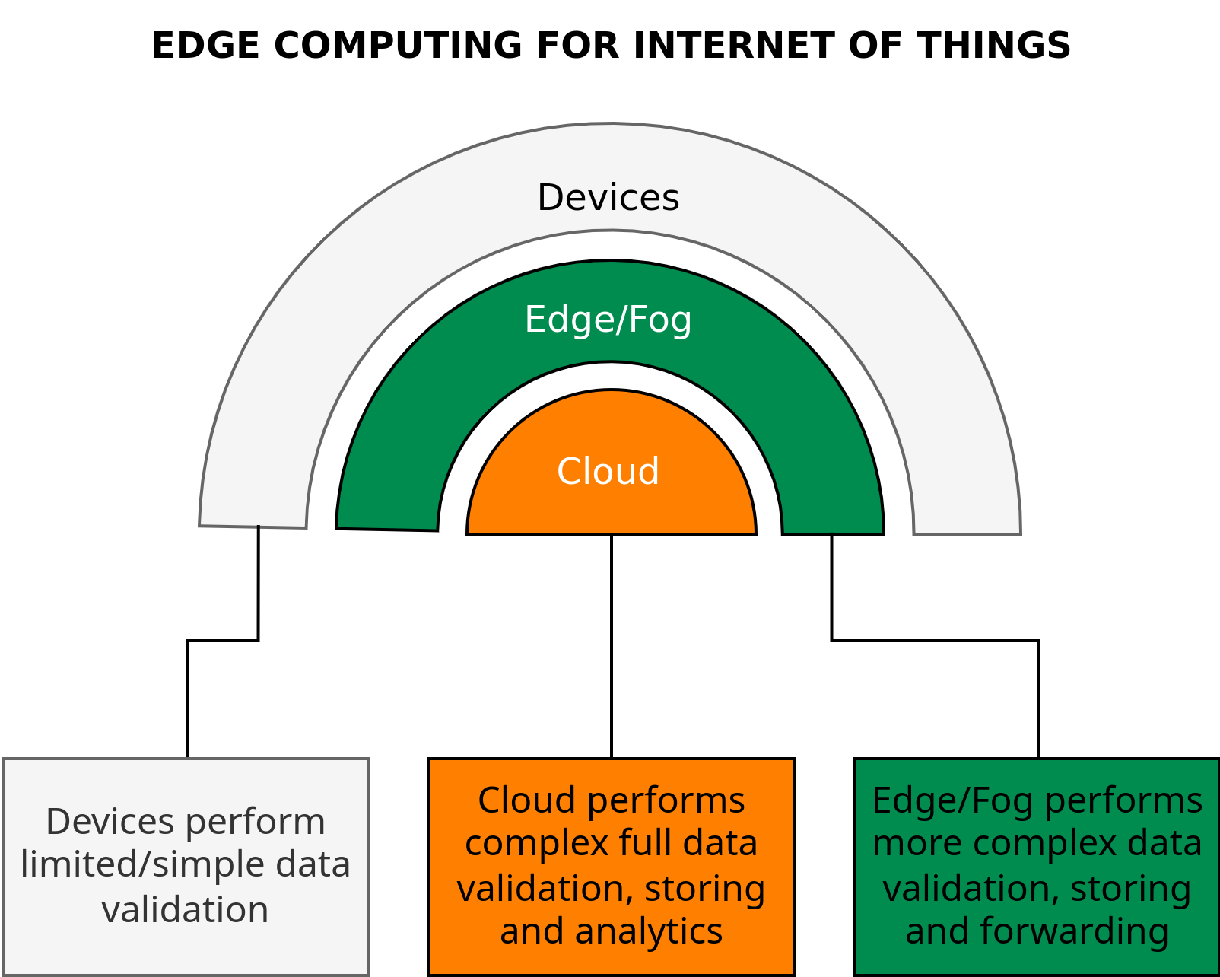
Edge/Fog for IoT
Image recreated from https://thecustomizewindows.com/2019/09/edge-computing-vs-cloud-computing/

Slide 39
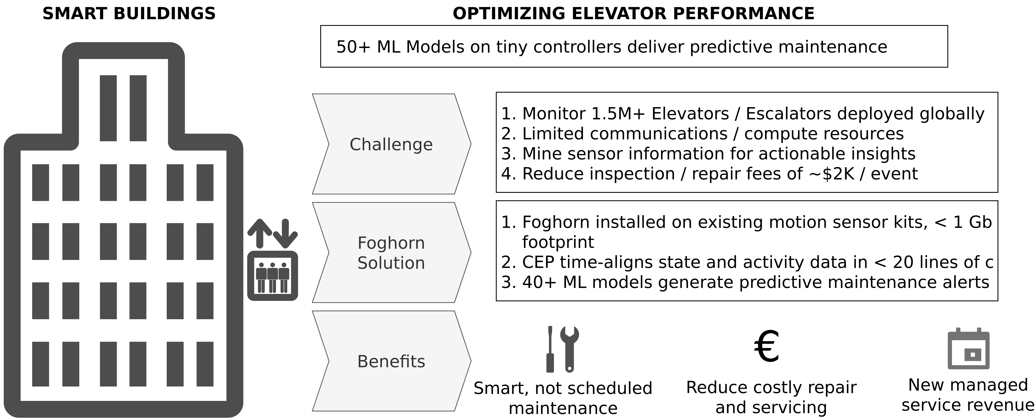
FogHorn – Example
Image recreated from http://web.stanford.edu/class/ee392b/lecture/may22/Foghorn.pdf

Slide 40
Edge Computing – Definition
“Edge computing refers to the enabling technologies al-lowing computation to be performed at the edge of the network, on downstream data on behalf of cloud services and upstream data on behalf of IoT services”
Shi, Weisong, Jie Cao, Quan Zhang, Youhuizi Li, and Lanyu Xu. "Edge computing: Vision and challenges." IEEE internet of things journal 3, no. 5 (2016): 637-646.

Slide 41
Fog Computing – Definition
“Fog computing is a geographically distributed computing architecture with a resource pool consists of one or more ubiquitously connected heterogeneous devices (including edge devices) at the edge of network and not exclusively seamlessly backed by cloud services, to collaboratively provide elastic computation, storage and communication (and many other new services and tasks) in isolated environments to a large scale of clients in proximity.”
Yi, Shanhe, Zijiang Hao, Zhengrui Qin, and Qun Li. "Fog computing: Platform and applications." In 2015 Third IEEE workshop on hot topics in web systems and technologies (HotWeb), pp. 73-78. IEEE, 2015.

Slide 42
Edge and Fog Computing – What’s the Difference?
Depends on who you ask

Slide 43
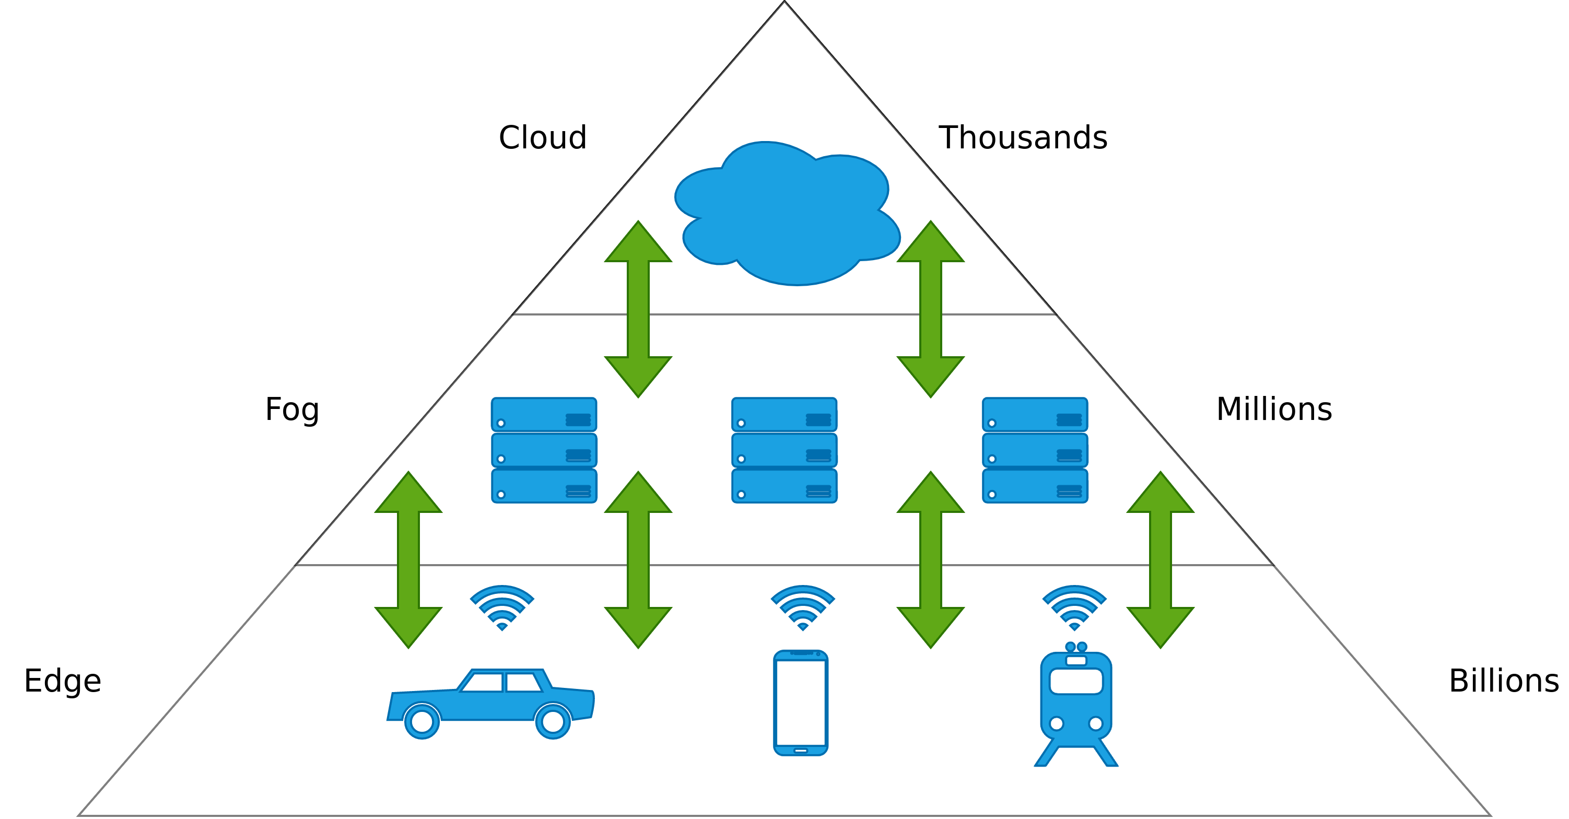
Architecture – Edge/Fog
Image recreated from https://blog.octo.com/en/edge-computing-learn-to-delegate/

Slide 44
Amazon Lambda – Serverless Computing
Event-driven (PUT to S3, API Call, etc.), serverless compute service that lets you run code without provisioning or managing servers
Allows for automated back-end provision services triggered by custom HTTP requests
Spin down services when not in use
Difference to AWS EC2 instances?
EC2 is priced by the hour but metered by the second
Lambda is metered by rounding up to the nearest millisecond with no minimum execution time

Slide 45
Amazon Lambda@Edge
Extension of AWS Lambda
Execution of the AWS Lambda Code in AWS Edge Locations (entry points into the AWS ecosystem, e.g. CloudFront).
Difference between Lambda and Lambda@Edge?
Lambda are regional services
Lambda@Edge is a global service
Lambda@Edge allows you to execute the logic across multiple location

Slide 46
Amazon Greengrass
IoT open source edge runtime and cloud service that helps you build, deploy, and manage device software
Enables AWS Cloud functions to be transferred to local devices
Capture and analyze data/events close to the source
Create AWS Lambda (serverless code) functions in the cloud and then deploy them to devices to run applications locally
Pro:
Fast and direct event processing
Works offline
Simplifies IoT development and reduces costs (BUT you still have to pay!)

Slide 47
AWS Snowcone | Snowball Edge | Snowmobile
 | AWS Snowcone | AWS Snowball Edge Storage Optimized | AWS Snowball Edge Compute Optimized | AWS Snowmobile
Usage Scenario | Edge computing, Data transfer, Edge storage | Data transfer, Edge storage | Edge computing, Data transfer | Data transfer
Usable HDD Storage | 8 TB | 80 TB | 42 TB | 100 PB
Usable SDD Storage | No | 1 TB | 7.68 TB | No
Usable vCPUs | 2 vCPUs | 40 vCPUs | 52 vCPUs | N/A
Usable Memory | 4 GB | 80 GB | 208 GB | N/A
GPU | No | No | Nvidia V100 (Optional) | No
Onboard Computing Options | AWS IoT Greengrass Amazon EC2 AMIs | AWS IoT Greengrass Amazon EC2 AMIs | AWS IoT Greengrass Amazon EC2 AMIs | N/A
DataSync | Yes | No | No | No
Transfers via S3 API | No | Yes | Yes | No
Device Size | 9 in x 6 in x 3 in | 28.3 in x 10.6 in x 15.5 in | 28.3 in x 10.6 in x 15.5 in | N/A
Device Weight | 2.1 kg | 22.3 kg | 22.3 kg | N/A
Encryption | 256-Bit | 256-Bit | 256-Bit | 256-Bit
Portability | Battery-Based operation | No | No | No
Wireless | Wi-Fi | No | No | No
Storage Clustering | No | Yes, 5-10 nodes | Yes, 5-10 nodes | N/A
HIPAA Compliant | Yes, eligible | Yes, eligible | Yes, eligible | No
Typical Job Lifetime | Offline or online data transfer: days-weeks Edge compute: weeks - years | Offline data transfer: days-weeks | Edge compute: weeks-years | Data-Migration: months
https://aws.amazon.com/snow/#Feature_comparison

Slide 48
Big Data

Slide 49
Big Data
More data ≠ More knowledge
More is not always better!

Slide 50
BigData – Definition
“BigData represents the information assets characterized by such a high volume, velocity and variety to require specific technology and analytical methods for its transformation into value”
De Mauro, Andrea, Marco Greco, and Michele Grimaldi. "What is big data? A consensual definition and a review of key research topics." In AIP conference proceedings, vol. 1644, no. 1, pp. 97-104. American Institute of Physics, 2015.

Slide 51
BigData – Definition
→ Large and complex data sets that are so massive that classic data processing software cannot manage them, but whose information value offers new solutions for existing business problems.
“BigData represents the information assets characterized by such a high volume, velocity and variety to require specific technology and analytical methods for its transformation into value”
De Mauro, Andrea, Marco Greco, and Michele Grimaldi. "What is big data? A consensual definition and a review of key research topics." In AIP conference proceedings, vol. 1644, no. 1, pp. 97-104. American Institute of Physics, 2015.

Slide 52
BigData – 4 V’s
Velocity
Variety
Veracity

Slide 53
BigData – 4 V’s
Volume
Velocity
Variety
Veracity

Slide 54
BigData – 4 V’s
Volume
Velocity
Variety
Veracity

Slide 55
BigData – 4 V’s
Volume
Velocity
Variety
Veracity

Slide 56
BigData – 4 V’s
Volume
Velocity
Variety
Veracity

Slide 57
BigData – Volume
Large amounts of structured and unstructured data
Various heterogeneous sources
Several TBs up to hundreds of PBs

Slide 58
BigData – Velocity
Rate at which new data is generated
Speed at with which data is transferred and analyzed
Best case:
Data processing is faster than data generation
Process data while it is being generated without having to write it into a database

Slide 59
BigData – Velocity
Rate at which new data is generated
Speed at with which data is transferred and analyzed
Best case:
Data processing is faster than data generation
Process data while it is being generated without having to write it into a database

Slide 60
BigData – Variety
Heterogeneity of data
Structured vs. unstructured
Data type and structure partly unknown (text, audio, video, etc.)
Who generates the data?
Humans
Sensors
Machines
Hardware
Software

Slide 61
BigData – Veracity
How accurate is the collected data → Can I trust it?
Lower quality can be compensated for by higher volume if necessary
Challenges:
Tweets with spelling mistakes or abbreviations.
→ e.g. u→you, thr→there, teh→the
Bias of data (e.g. political).
Detect and filter noise and abnormalities

Slide 62
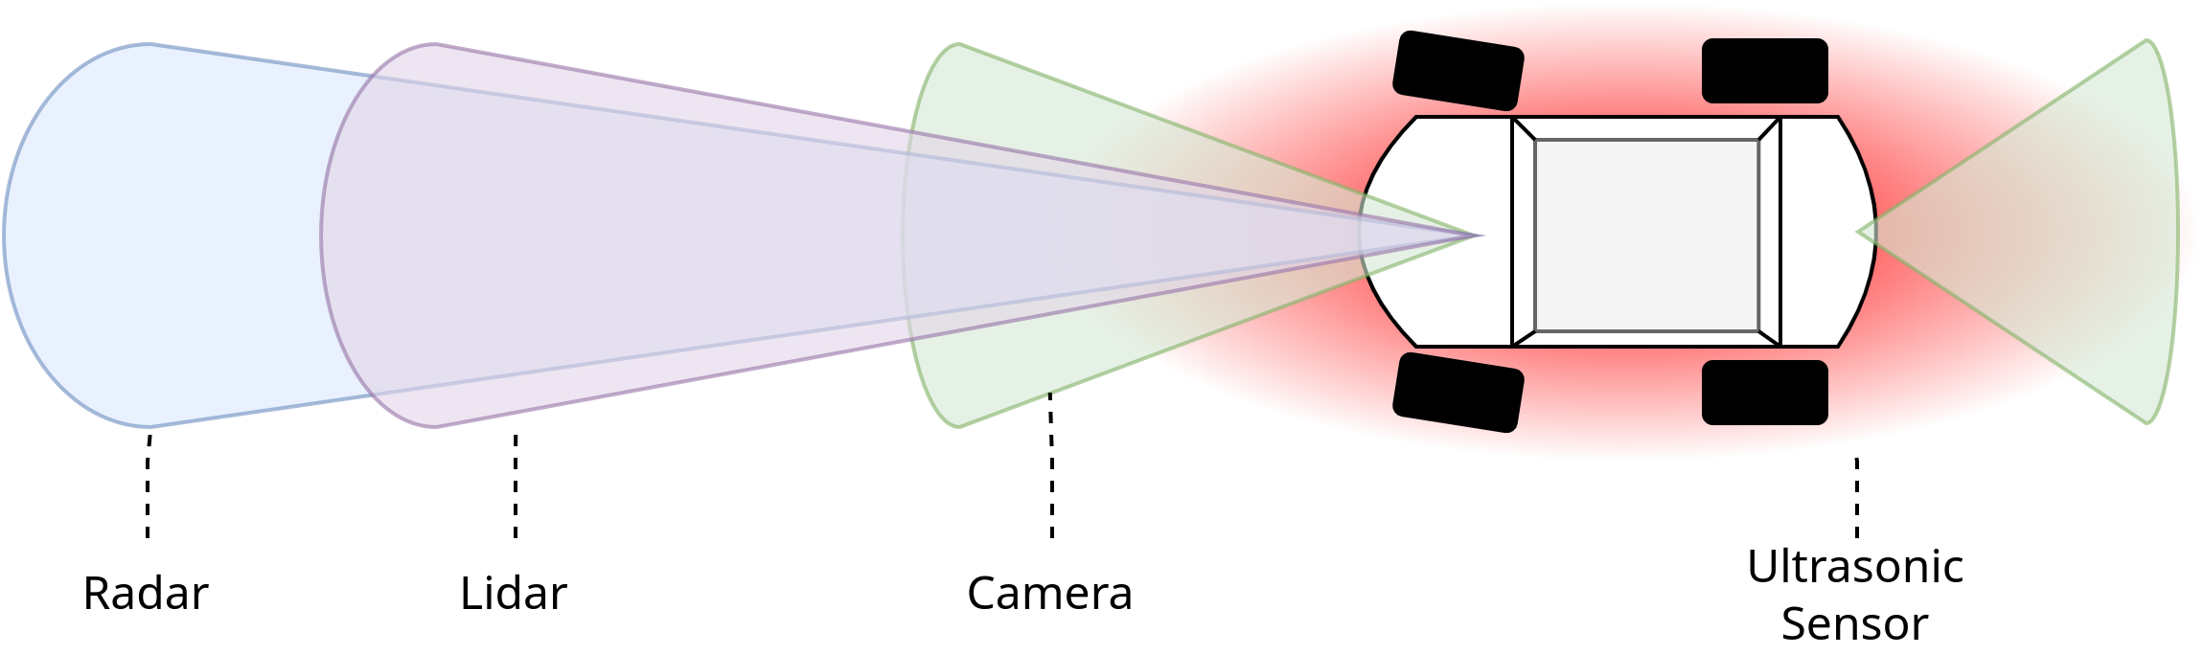
Challenges – Data Volumes
RADAR
4-6 Sensors: 0.1 – 15 Mbit/s per Sensor
LIDAR
1-5 Sensors: 20 – 100 Mbit/s per Sensor
CAMERA
6-12 Sensors: 500 - 3500 Mbit/s per Sensor
ULTRASONIC
8-16 Sensors: < 0.01 Mbit/s per Sensor
VEHICLE MOTION, GNSS, IMU
< 0.1 Mbit/s per Sensor
Total Sensor Bandwidth = 3 Gbit/s (~ 1.4 TB/h) or 40 Gbit/s (~ 19 TB/h)
Image recreated from Heinrich, Stephan – Lucid Motors, „Flash Memory in the emerging age of autonomy“, Flash Memory Summit 2017 – https://www.flashmemorysummit.com/English/Collaterals/Proceedings/2017/20170808_FT12_Heinrich.pdf

Slide 63
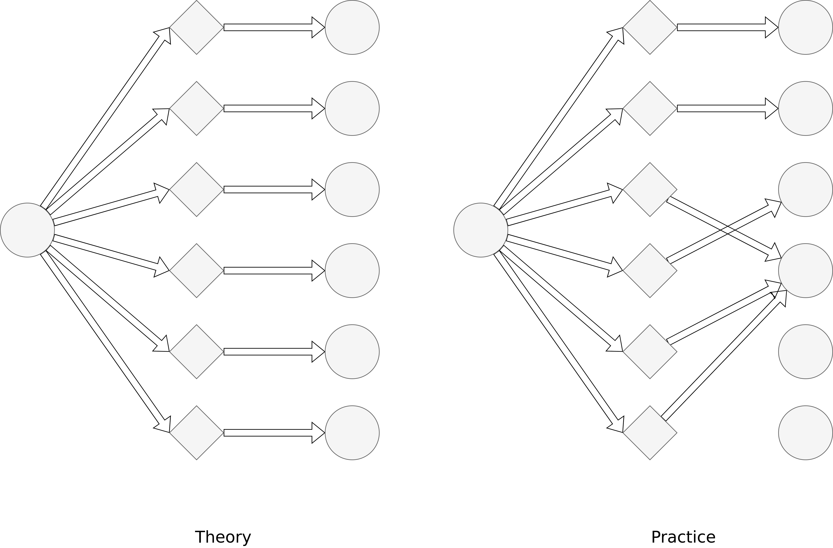
Challenges – Scalability

Slide 64
Machine Learning

Slide 65
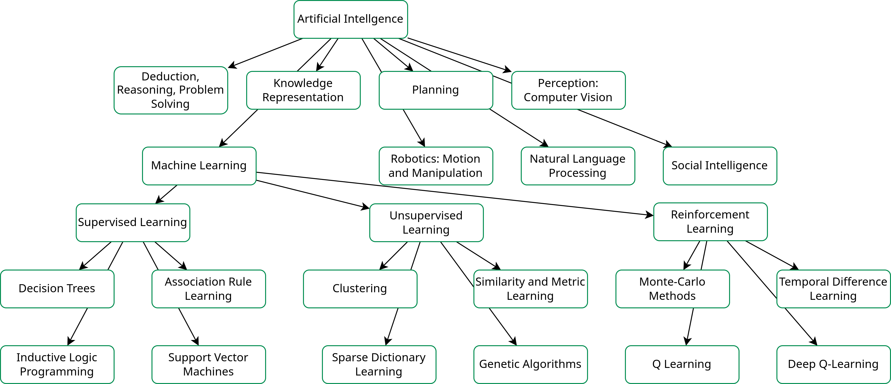
Overview
Image recreated based on Ajit Nazre and Rahul Garg, “A Deep Dive in the Venture Landscape of Artificial Intelligence and Machine Learning”, 2015.

Slide 66
Supervised Learning
The objective is to assign data to a class/grouping that is specified by the user. The key challenge is to build a model with the help of sample data, which then takes over the assignment independently.
Advantage:
Leads to good results even with small amounts of data.
Disadvantage:
Data must be labelled.

Slide 67
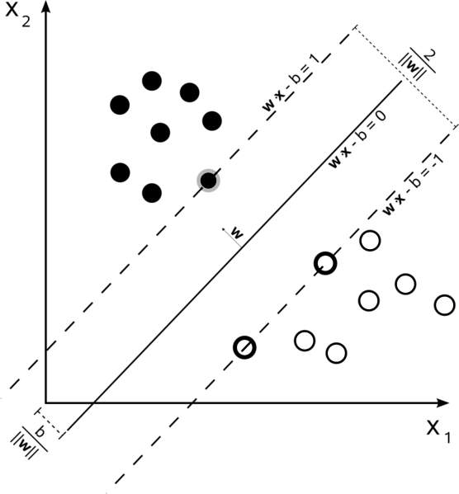
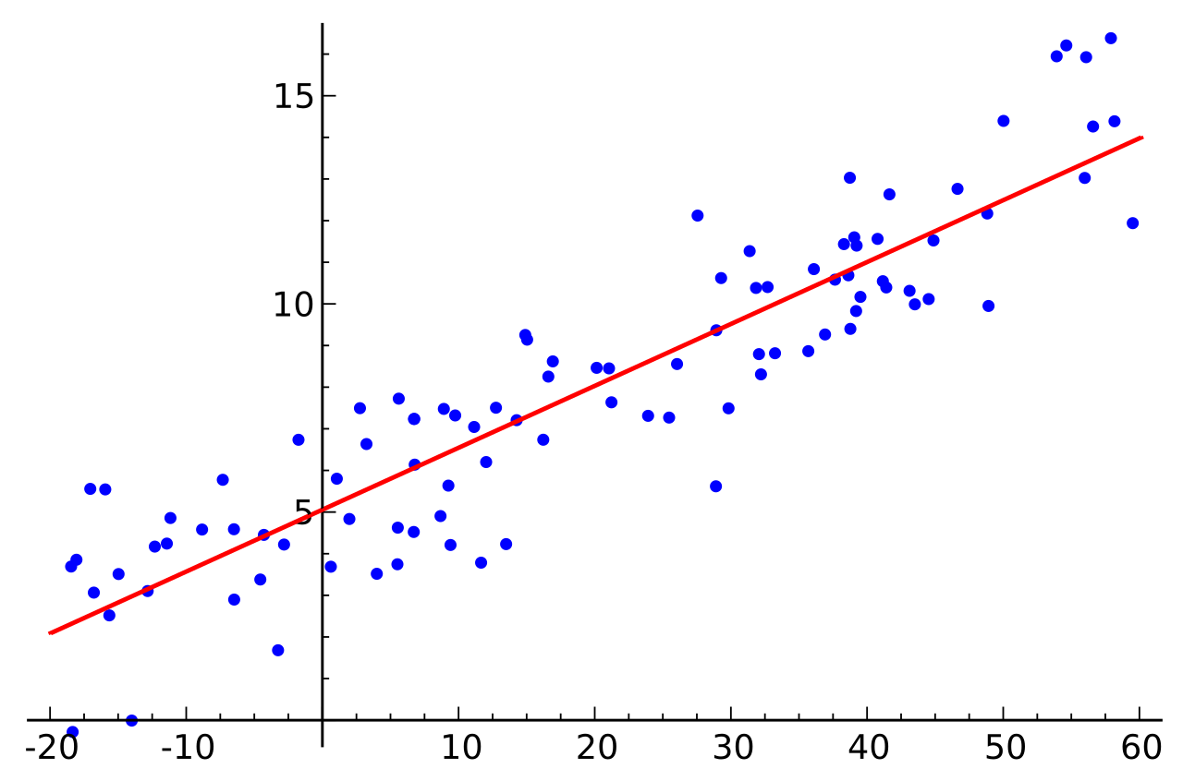
Supervised Learning – Examples
Classification problems:
Patient has disease X or not
E-mail is spam or not
Regression problems:
Prediction of stock prices
Prediction of real estate prices
„Linear Regression” by Sewaqu is sourced from the public domain.
“Graphic showing the maximum separating hyperplane and the margin.” by Cyc is sourced from the public domain.

Slide 68
Unsupervised Learning
The objective is to identify unknown structures and relationships amongst data. The grouping and the division of the individual data sets is unknown.
Advantage:
No labels necessary
Disadvantage:
Requires large amounts of data

Slide 69
Unsupervised Learning – Examples
Text analysis
Speech analysis
Image recognition and processing
→ Results are used, for example, in voice assistant systems or social bots

Slide 70
Reinforcement Learning
An algorithm learns through trial and error about its environment and which actions it can perform. The executed actions of the algorithm are either "rewarded" or "punished" → reinforcement learning.
Advantage:
Allows the programming of autonomously acting systems
Disadvantage:
Complex structure and training process.

Slide 71
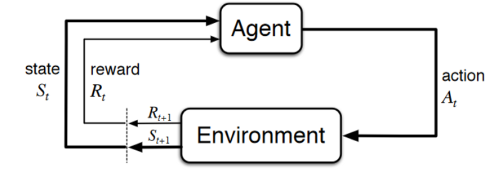
Reinforcement Learning – Examples
Robotics
Chemistry (optimization of chemical reactions)
Recommendation systems (Amazon)
“Reinforcement learning diagram of a Markov decision process based on a figure from 'Reinforcement Learning An Introduction' second edition by Sutton and Barto.” by EbattleP is licensed under CC BY-SA 4.0 (https://creativecommons.org/licenses/by-sa/4.0/)

Slide 72
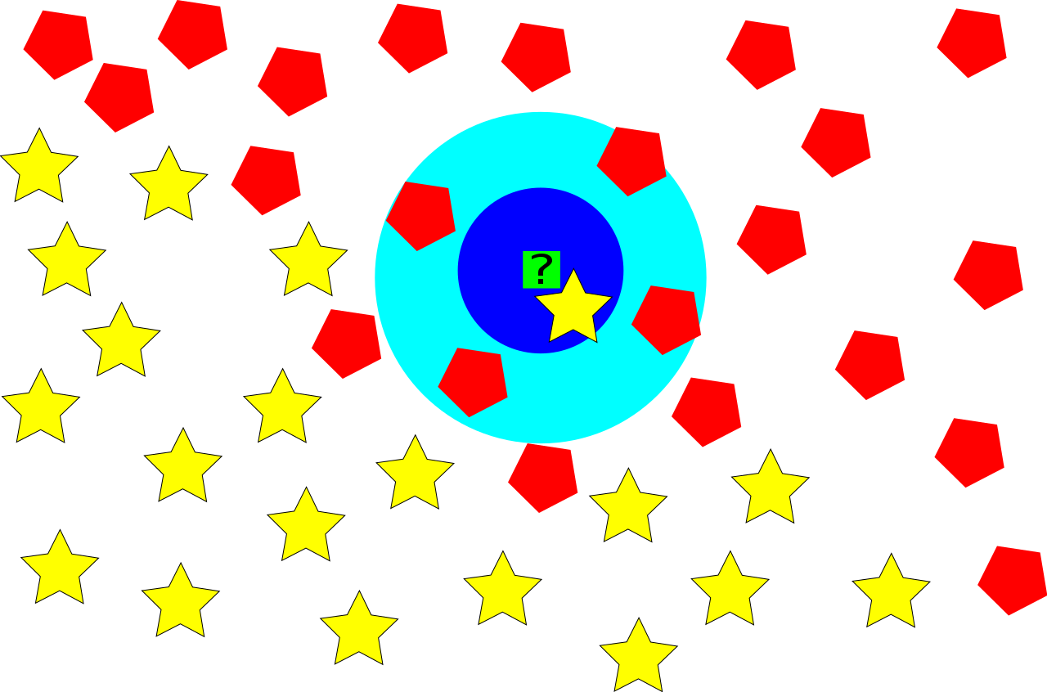
K-Nearest Neighbor
Drichel, Alexander, „Klassifikation im R^2 durch das k-nearest-neighbor Verfahren (k=1, k=5)“ – https://de.wikipedia.org/wiki/Datei:KNNClass.svg is licensed under CC BY-SA 2.0 (https://creativecommons.org/licenses/by-sa/2.0/de/legalcode)

Slide 73
Data Analytics

Slide 74
Overview
Includes the process of inspection, cleaning/preparation, transforming and modelling data for the purpose of extraction of useful information.
Extracted information is the basis for subsequent decision-making processes
Often in conjunction with data visualization
⇒ Value of collected data depends on their interpretation and the decisions that are made on the basis of the data.

Slide 75
Overview
Includes the process of inspection, cleaning/preparation, transforming and modelling data for the purpose of extraction of useful information.
Extracted information is the basis for subsequent decision-making processes
Often in conjunction with data visualization
⇒ Value of collected data depends on their interpretation and the decisions that are made on the basis of the data.

Slide 76
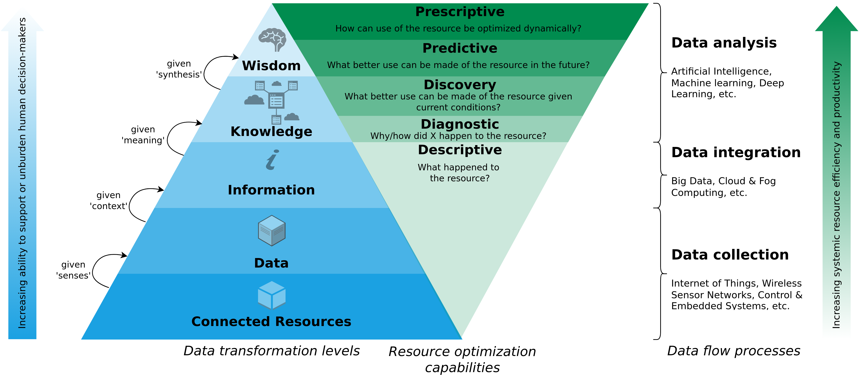
A Data-Driven Smart CE Framework
Image recreated from Kristoffersen et al. (2020) – The smart circular economy: A digital-enabled circular strategies framework for manufacturing companies.

Slide 77
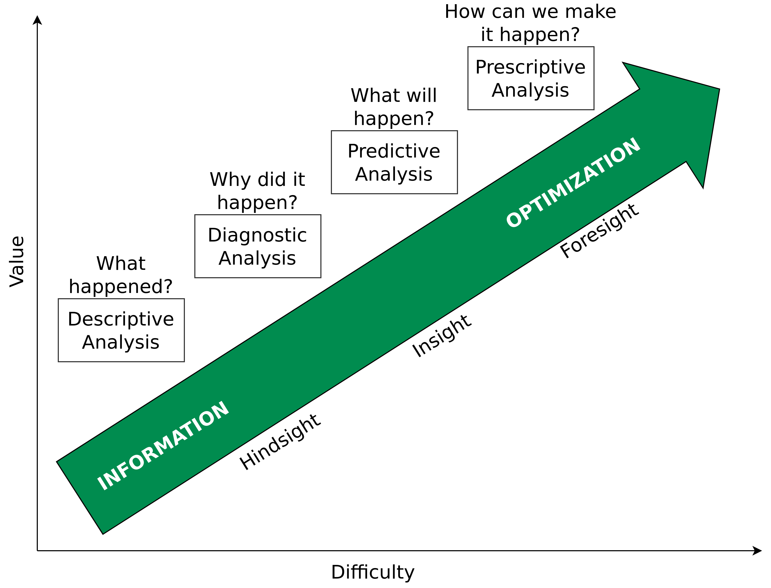
Data Analytics – Overview
Image recreated from https://www.gartner.com/it-glossary/predictive-analytics/

Slide 78
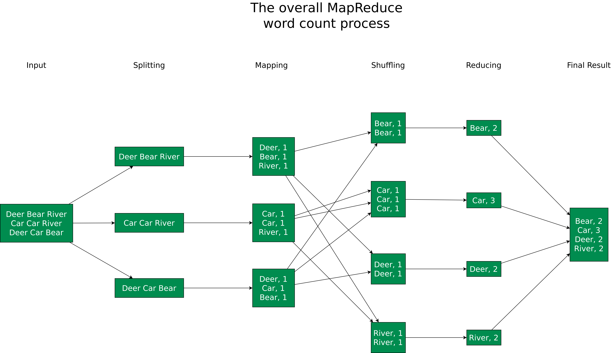
Data Processing Example – Map Reduce
Image recreated from https://blog.trifork.com/2009/08/04/introduction-to-hadoop/

Slide 79
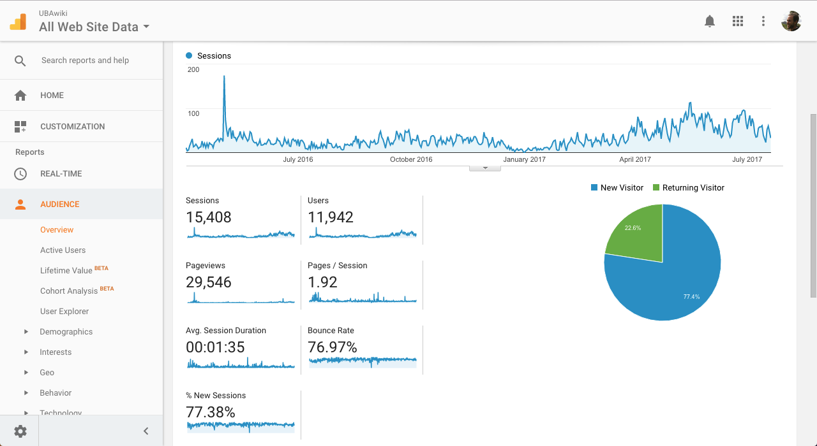
Data Visualisation Example – Google Analytics
Screenshot of the Google Analytics Audience screen for http://uba.wiki is licensed under CC BY-SA 4.0 (https://creativecommons.org/licenses/by-sa/4.0/deed.en)

Slide 80
Predictive Analytics
Classification of new observations on the basis of training data from the past
It is not a question of predicting the future!
→ Instead, to calculate the probability of the (non-)occurrence of an event with a certain degree of reliability.
Possible applications in the creation of what-if scenarios, Risk management or outlier analyses

Slide 81
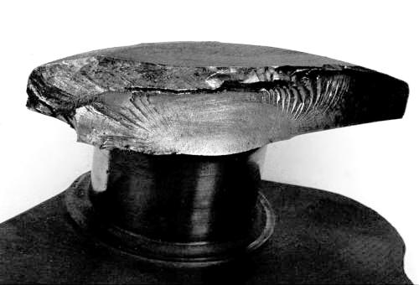
Predictive Analytics Example – Engine Vibrations
Monitoring of the vibrations of specific engine parts
Analysis of measured vibrations via Fast Fourier Transform (FFT)
Observation over time reveals increasing deviations from normal values
Predictions about quality and deterioration
„Crankshaft fatigue“ is licensed under CC BY-SA 3.0 Unported (https://creativecommons.org/licenses/by-sa/3.0/deed.en)

Slide 82
Real-Time Data Analytics
When do I analyze data?

Slide 83
Real-Time Data Analytics
When do I analyze data?
After an event has occurred? ⇒ Data at rest
or

Slide 84
Real-Time Data Analytics
When do I analyze data?
After an event has occurred? ⇒ Data at rest
or
While an event occurs? ⇒ Data in motion

Slide 85
Real-Time Data Analytics – Stream Processing
Problem:
Processing of continuous data streams
Answering question X without delay
Examples:
E-commerce order processing
Credit card fraud detection
Spam detection
etc.

Slide 86
Real-Time Data Analytics – Stream Processing Properties
Results for question X based on current data
Calculation on individual data set or for a small time window
Optimized for low latency
Calculations close to "real-time" and often very simple
Example frameworks: Apache Storm or Amazon Kinesis

Slide 87
Exercise E06

Slide 88
E06 – IoT Security
In previous exercises, you gathered data from different sources (e.g., weather sensors/APIs) and aggregated them into a single data set. Subsequently, you processed the data to make predictions based on the results of the gathered information.
However, so far, we have discarded the aspect of privacy and security when handling IoT-related data. Especially the transmission of data from the sensors to the processing entity (cloud, edge, etc.) is often prone to data manipulation. Moreover, the sensor data might contain sensitive information that is not meant to be public. Therefore, data in transit must be protected against manipulation and encrypted.

Slide 89
Questions?

